Slide 1
FORTUNE TELLING
Jose Ramirez, Joseph Jacobs, Ian Schaak, Olivia Stanich

Slide 2

CONCEPTION OF THE GAME
Tarot cards have been used all throughout history. Tarot cards originated in the 15th century in Europe, initially as playing cards for games like tarocchi in Italy and tarot in France.
The earliest known deck is the Visconti-Sforza deck, created around 1440 in Milan, Italy.
In the 18th century, interest in tarot cards shifted from gaming to divination and spiritual practices.
Antoine Court de Gébelin, a French Freemason and scholar, proposed that tarot cards held mystical and ancient Egyptian origins, though this theory lacks historical evidence.
Created in 1909 by artist Pamela Colman Smith under the guidance of occultist A.E. Waite, the Rider-Waite-Smith deck became the most widely recognized and influential tarot deck. Still today this is the most popular deck used.

Slide 3

DIGITAL TAROT READING
Tarot gained popularity throughout the 20th century due to renewed interest in mysticism, spirituality, and the New Age movement.
Despite the rich history, not everyone has a tarot deck or know how to find people who do professional readings. We wanted to digitalize the tarot reading and make it easier for people to learn about tarot and readings.

Slide 4
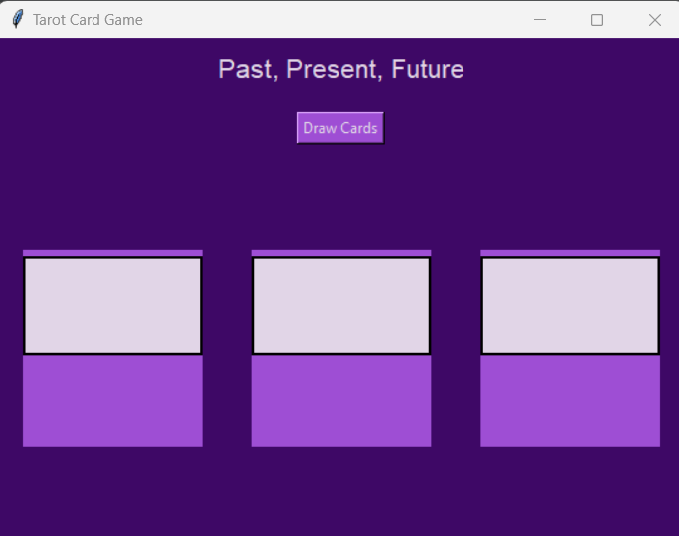
THE POWER OF COMMUNICATION
This Python program utilizes the tkinter library to create a graphical user interface (GUI) that randomly draws three tarot cards from the Major Arcana deck with each click of the "Draw Cards" button. Each card, selected from a predefined set, can appear either upright or reversed, influencing its interpretation and meaning. The program displays the card names and their corresponding interpretations dynamically on the interface, providing insights into past, present, and future aspects. Through this interactive experience, users can explore the symbolism and messages associated with each card, reflecting themes such as destiny, personal growth, and spiritual guidance. Let's delve into the mystical world of tarot and uncover its timeless wisdom.

Slide 5
SELECTING VISUAL AIDS
Enhancing Our Design

Slide 6
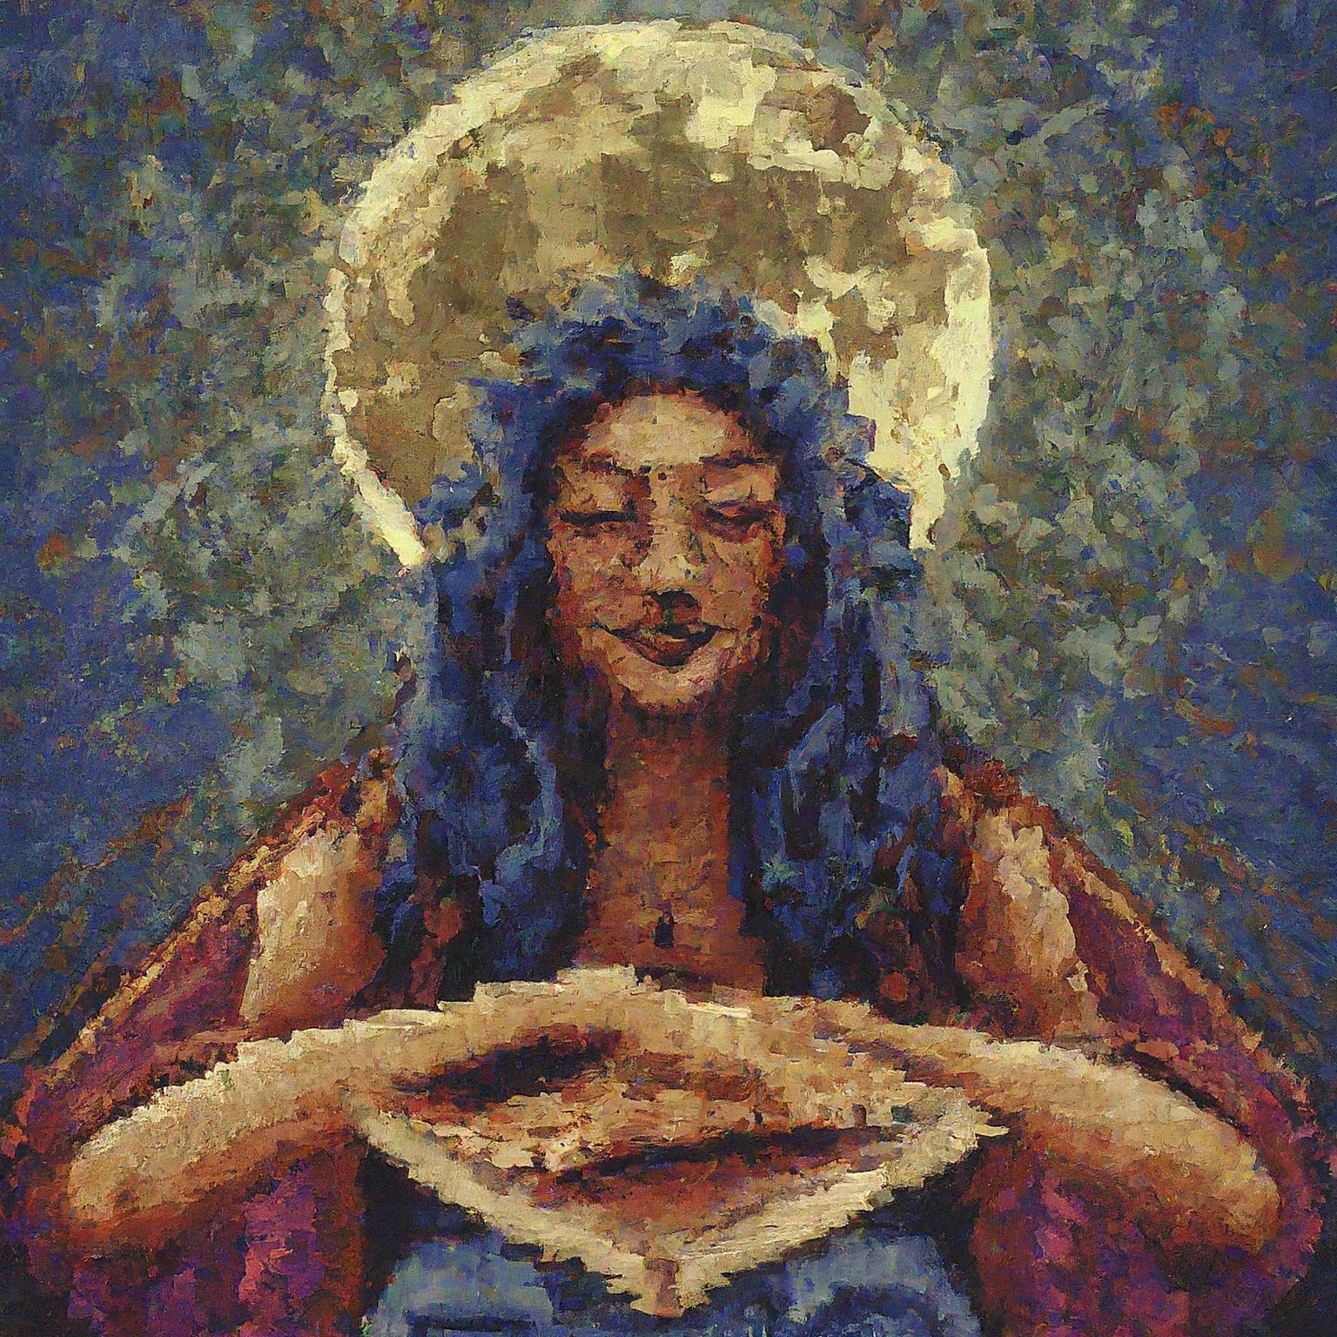
Each card is represented by stunning pixel art. That conveys a sense of the old ways. This image to the right represents “The High Priestess”

Slide 7
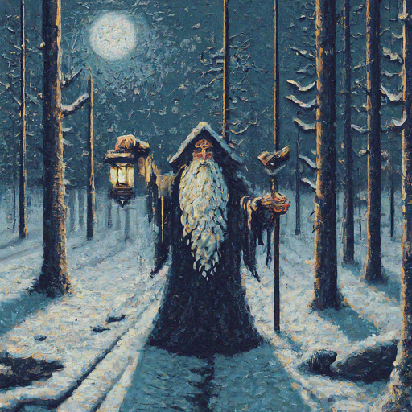
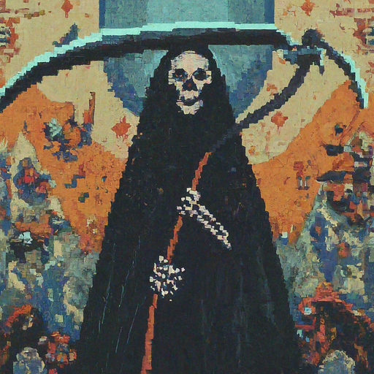
EACH IMAGE WAS AI GENERATED AND WAS TOUGH TO GET EVERY IMAGE TO LOOK SIMILAR TO EACH OTHER.

Slide 8
TEAM COLLABORATION

Slide 9

OUR COLLABORATED JOURNEY
We leveraged modern software tools like GitHub and Discord to facilitate seamless collaboration and efficient project management.

Slide 10

GITHUB FOR CODE MANAGEMENT
We used GitHub to manage our codebase, enabling version control and collaborative reviewing.
This allowed us to track changes, fix bugs collaboratively, and merge contributions effectively.

Slide 11

DISCORD FOR COMMUNICATION
Our team communicated in real time using Discord, which helped us stay connected and informed throughout the project's lifecycle.
We used Discord for daily stand-up meetings, brainstorming sessions, and quick troubleshooting.

Slide 12
General Interactions

Slide 13
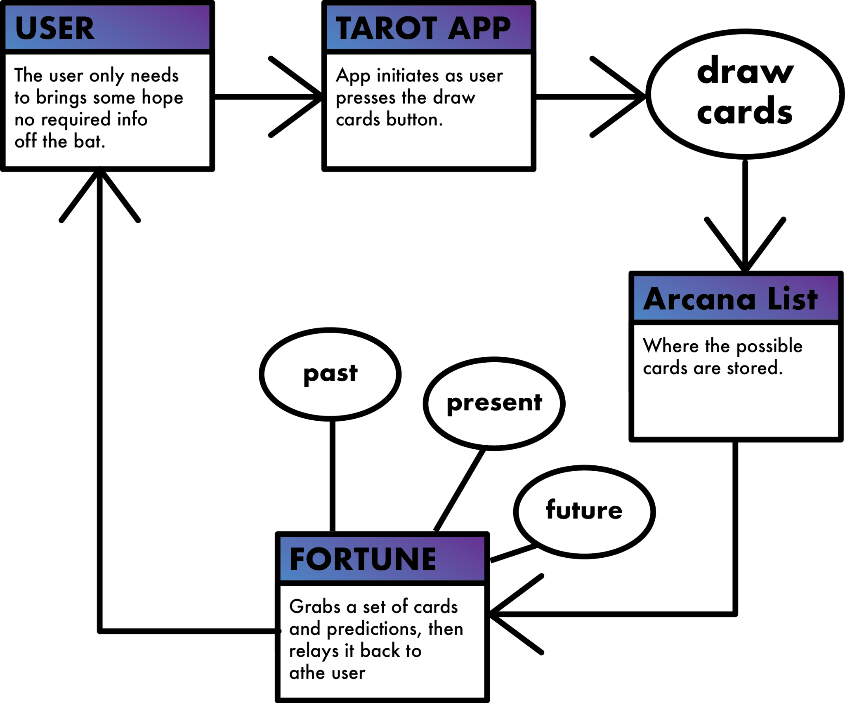
User Presence is Required
The application will yield fortunes to be read. There are no long drawn out background operations. The user hits a button and is given their fortune.

Slide 14

We are not responsible for any issues that may come from these fortunes
Some find that knowing their fate is a curse, and legends and lore in history have backed that up. Choosing to use this application should be done at your own risk, try not to take it all too seriously.

Slide 15

THANK YOU

